Slide 1
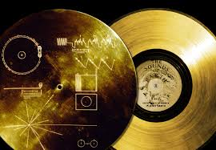
Case study: The Voyager Golden Record to communicate about earthlinks to aliens

Slide 2
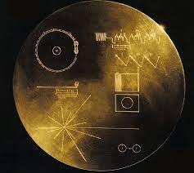
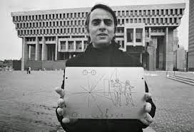
The Voyager Golden Record
http://voyager.damninteresting.com/

Slide 3
Quick recap;
(10 Minutes)
Sensation?
Initial detection of energy from the physical world
Perception?
Involves higher-order cognition in the interpretation of sensory information
Sensation occurs when sensory receptors detect sensory stimuli. Perception involves the organization, interpretation, and conscious experience of those sensations.

Slide 4

Let’s look at some examples:
Light—vision
Sound—hearing
Pressure, temperature, pain—a sense of touch
Orientation, balance—kinesthetic senses
Environmental information (stimuli) exists in many forms.
A physical stimulus must first be introduced for sensation and perception. For example, air vibrations, gases, chemicals, tactile pressures

Slide 5
Few related terms
Thresholds
Absolute threshold a. The point at which a stimulus can be detected 50 percent of the time b. Given a particular stimulus, the minimum stimulation needed for detection
Difference threshold a. The minimal change in stimulation that can be reliably detected 50 percent of the time b. Also called the just noticeable difference (jnd)
To get an idea of the range of sounds that the human ear can sense, test your hearing here: http://test-my-hearing.com

Slide 6
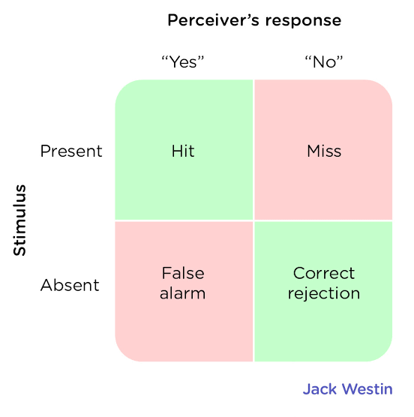
Signal-detection theory: theory which suggests how individuals are able to detect a minimal stimulus (signal) among other background stimuli (noise). This may influence how individuals make a decision in a specific situation
https://study.com/academy/lesson/signal-detection-theory-definition-examples.html#quiz-course-links

Slide 7
SUMMARY
Sensation is the process of receiving information from the environment through our sensory organs. Perception is the process of interpreting and organizing the incoming information so that we can understand it and react accordingly
Transduction is the conversion of stimuli detected by receptor cells to electrical impulses that are transported to the brain.
Although our experiences of the world are rich and complex, humans — like all species — have their own adapted sensory strengths and sensory limitations.
Sensation and perception work together in a fluid, continuous process.
Our judgments in detection tasks are influenced by both the absolute threshold of the signal as well as our current motivations and experiences. Signal detection analysis is used to differentiate sensitivity from response biases.
The difference threshold, or just noticeable difference, is the ability to detect the smallest change in a stimulus about 50% of the time. According to Weber’s law, the just noticeable difference increases in proportion to the total intensity of the stimulus.
Research has found that stimuli can influence behaviour even when they are presented below the absolute threshold (i.e., subliminally). The effectiveness of subliminal advertising, however, has not been shown to be of large magnitude.

Slide 8
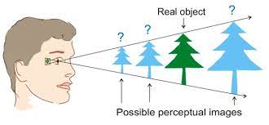
How an object is perceived?
The image can vary for the same object in terms of the context with which it is viewed, the apparent size of the object, the angle from which it is viewed, how illuminated it is, as well as where it resides in the field of vision

Slide 9
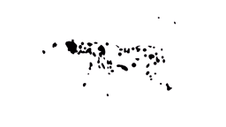
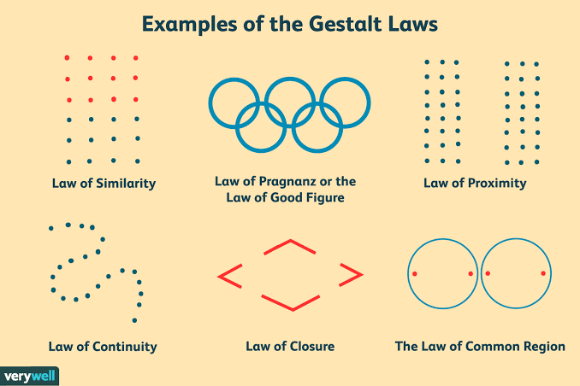
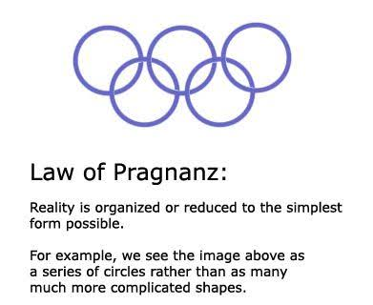
Perceptual abilities illusions

Slide 10
The golden record- voyager NASA
NASA launched voyager I and II to explore the outer solar system
Both crafts carry golden records: 12-inch phonographic gold-plated copper records, designed to last indefinitely in interstellar space.
Inscribed on the records’ covers are instructions for their use and a sort of “map” designed to describe the Earth’s location in the galaxy in a way that extraterrestrials might understand.
Contained ordinary audios and 115 encoded images

Slide 11
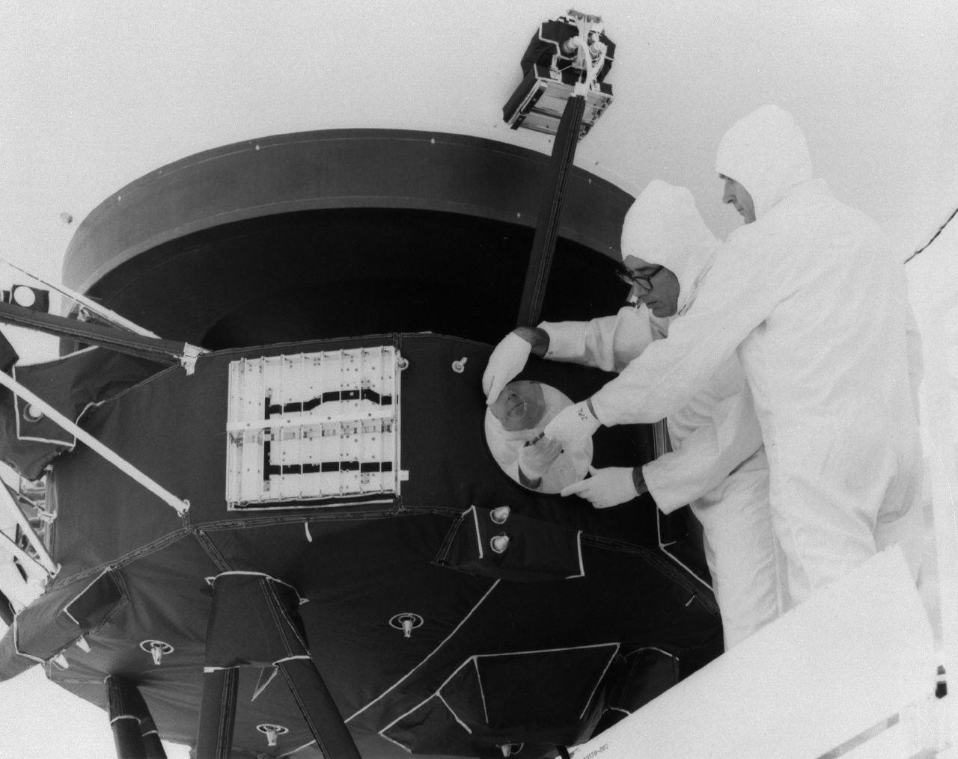
A team led by astronomer Carl Sagan selected the contents, chosen to embody a message representative of all of humanity.
Since we still have not detected any alien life, we cannot know to what degree the records would be properly interpreted.
Given the vast distances between the stars, it’s not realistic to expect an answer to these messages within many human lifetimes.

Slide 12

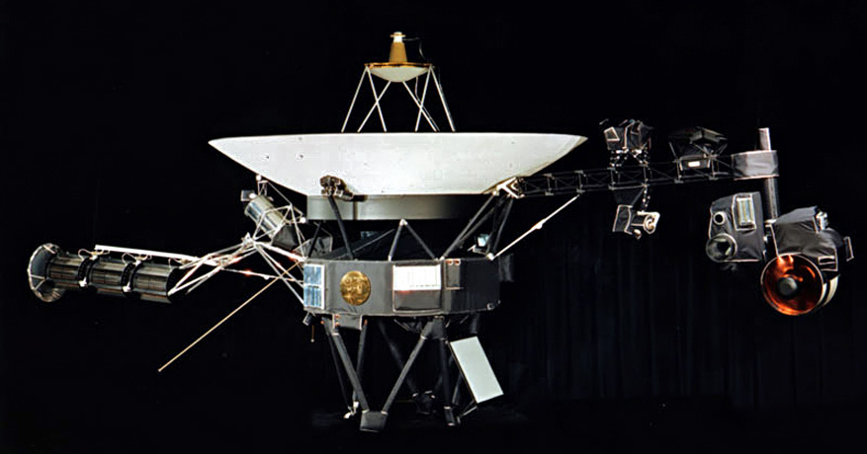
But the records serve a broader purpose than spreading the word that we’re here on earth.
The records also represent humanity’s deliberate effort to put artifacts among the stars.

Slide 13
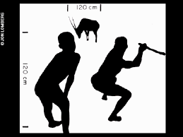
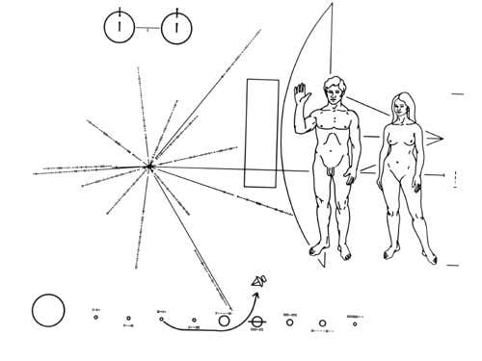
Unlike everything on Earth, which is subject to erosion and all the Golden Records are essentially eternal, a permanent time capsule of humanity.
The Golden Records’ one purpose is to serve as ambassadors of humanity to the stars.
Notes:
The Voyager spacecraft – was designed to have finite lifespans and whose journey into interstellar space was incidental to their primary function of exploring the outer planets.

Slide 14
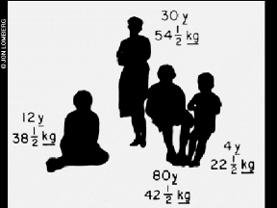
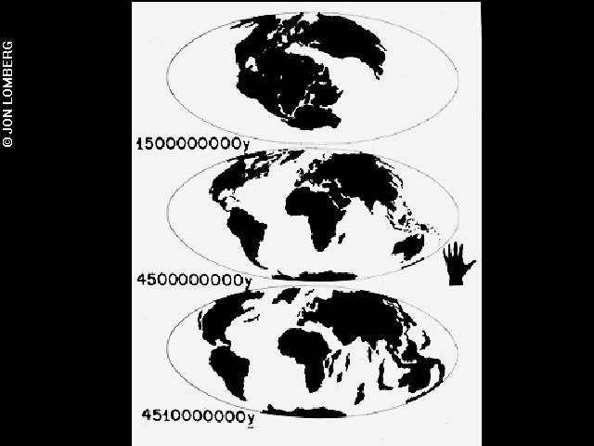
By imagining that others are listening/viewing, we reflect upon ourselves, open ourselves and our cultures, and think of how to represent ourselves to a different world.

Slide 15

How an object is perceived?
We perceive objects in different manners as compared to their position in the environment.

Slide 16
Form perception
Form perception refers to our ability to visually perceive objects in the world in response to the patterns of light that they caste on our retinas.
Recognition of visual elements of objects – such as shapes, patterns, and previously identified important characteristics.
Each instance of observing an object leads to a unique retinal response pattern,
The visual processing in the brain recognizes these experiences as analogous and helps to recognize objects.
Object recognition is assigning labels to objects to categorize and identify them, thus distinguishing one object from another.

Slide 17
ACTIVITY – you have 20 minutes!
Divide into groups and Discuss on the following:
Given a chance, what would you wish to communicate with aliens?
How would you represent it visually, and why?
What are your assumptions regarding the process of perception while forming this message of communication?
How would it differ from the voyager’s attempt?

Slide 18

DISCUSSION

Slide 19
Explore more;
https://www.damninteresting.com/voyager-golden-record/

